Slide 1
KIDS LEARN AND PLAY Website
NAME : BHARAT MUNDHRA
REGISTER NO. : 36110166
DEPARTMENT : CSE
SECTION : C
NAME OF THE GUIDE : Ms. B. KEERTHI SAMHITHA, M. Tech.,

Slide 2
Abstract
Children explore websites for fun as well as to learn.
They feel very interesting to learn in an interactive way.
Many interactive designing elements and layouts are present which can hold child’s attraction towards the website.
So the kids not only learn but they enjoy the way of learning.

Slide 3
introduction
The website is for kids education and entertainment.
They can learn their basics like alphabets and number with their pronunciation.
They can listen poetries and can play games.

Slide 4
objectives
Give KNOWLEDGE to the children
Build INTERACTION towards the webpage
ENTERTAINMENT for kids

Slide 5
Architectural view
HOME PAGE
ALPHABETS PAGE
NUMBERS PAGE
POETRY PAGE
PLAY PAGE

Slide 6
IMPLEMENTATIONs
The scripting languages used for making the website are HTML5 and CSS3.
These are some implementations done in the entire project :
1. Background colours
2. Background images
3. Font style, colour and size
4. Margins
5. Alignments
6. Images
7. Audios
8. Buttons
9. Links

Slide 7
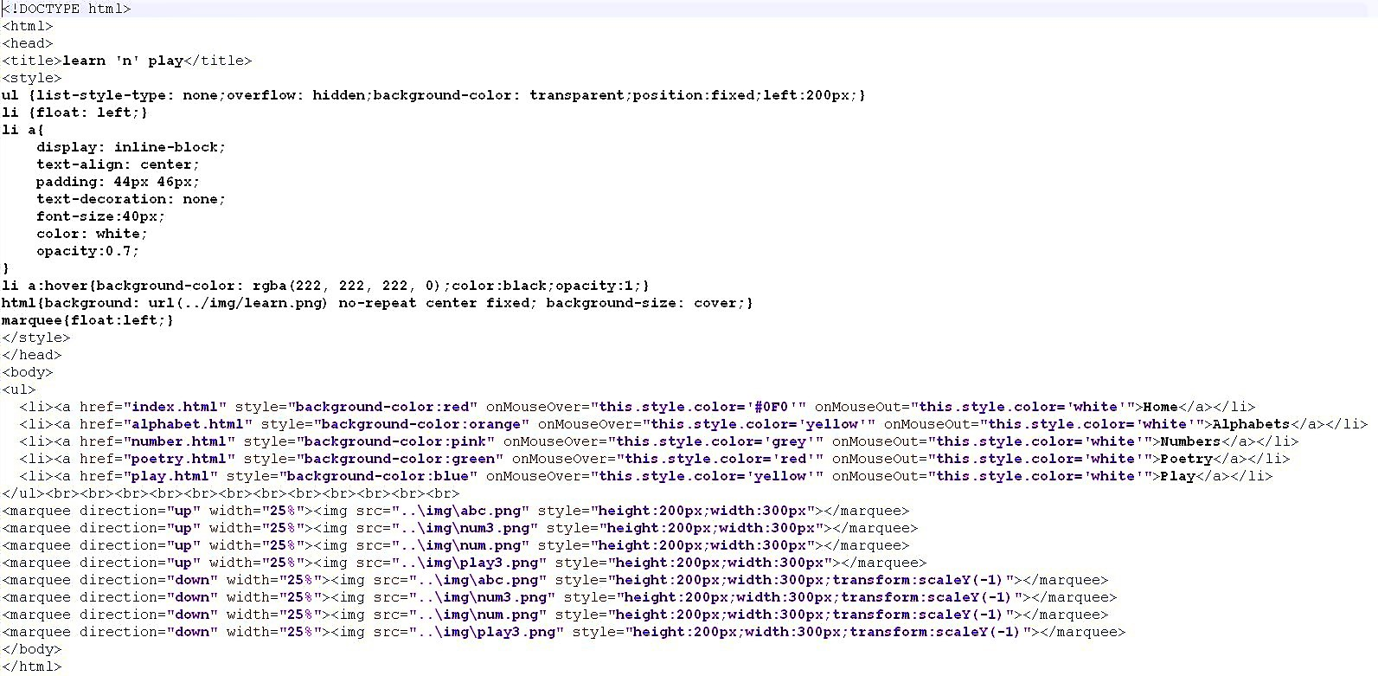
Code sample
Code for Home page :

Slide 8
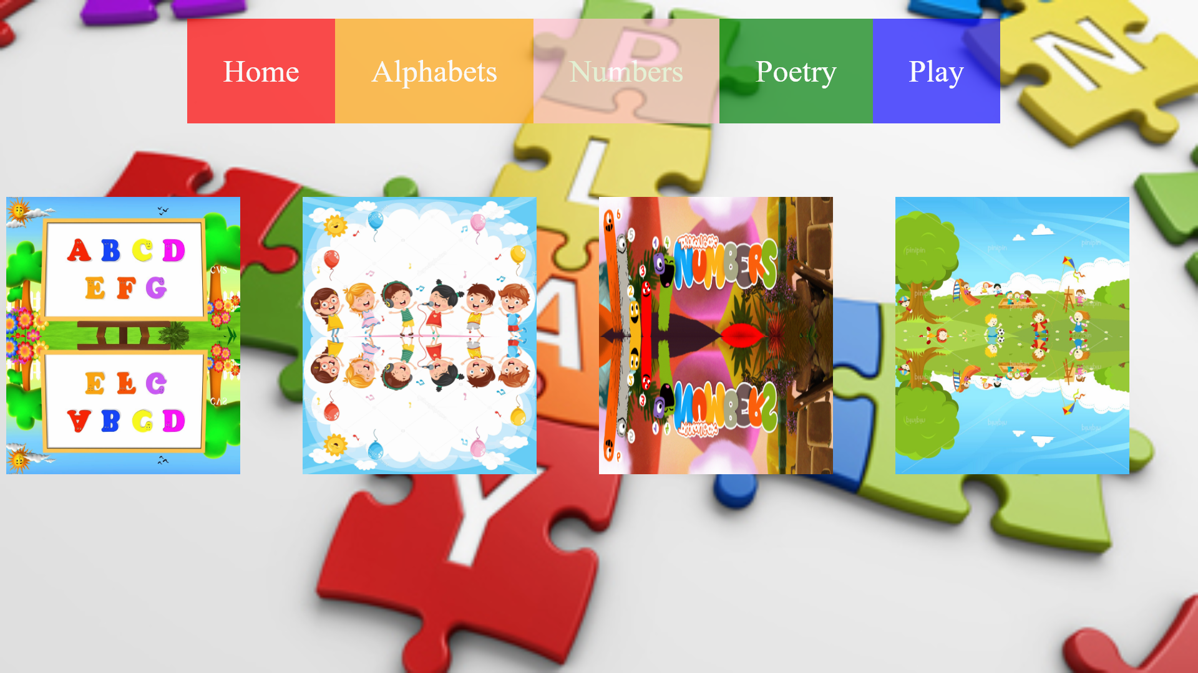
RESULTS & DISCUSSIONS
HOME PAGE :
All the links of other pages are present in the form of Navigational Bar.

Slide 9
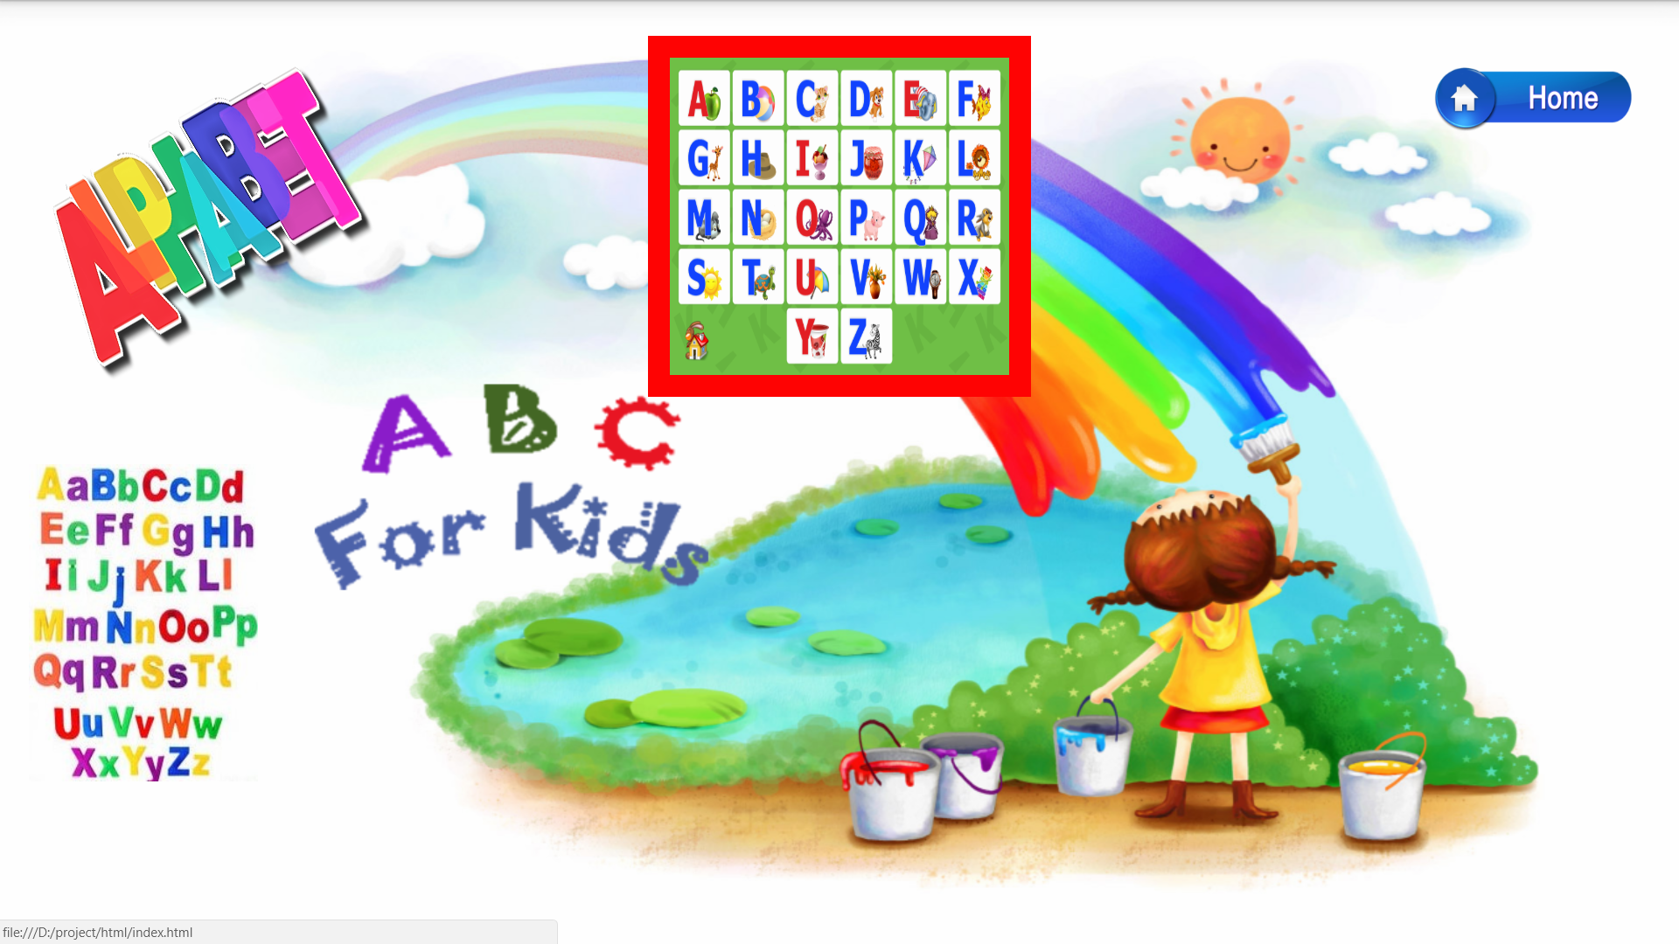
ALPHABETS PAGE :
All the alphabets are present in this page. Audio of the pronunciation of a particular alphabet can be played by pointing and clicking the respective alphabets.

Slide 10
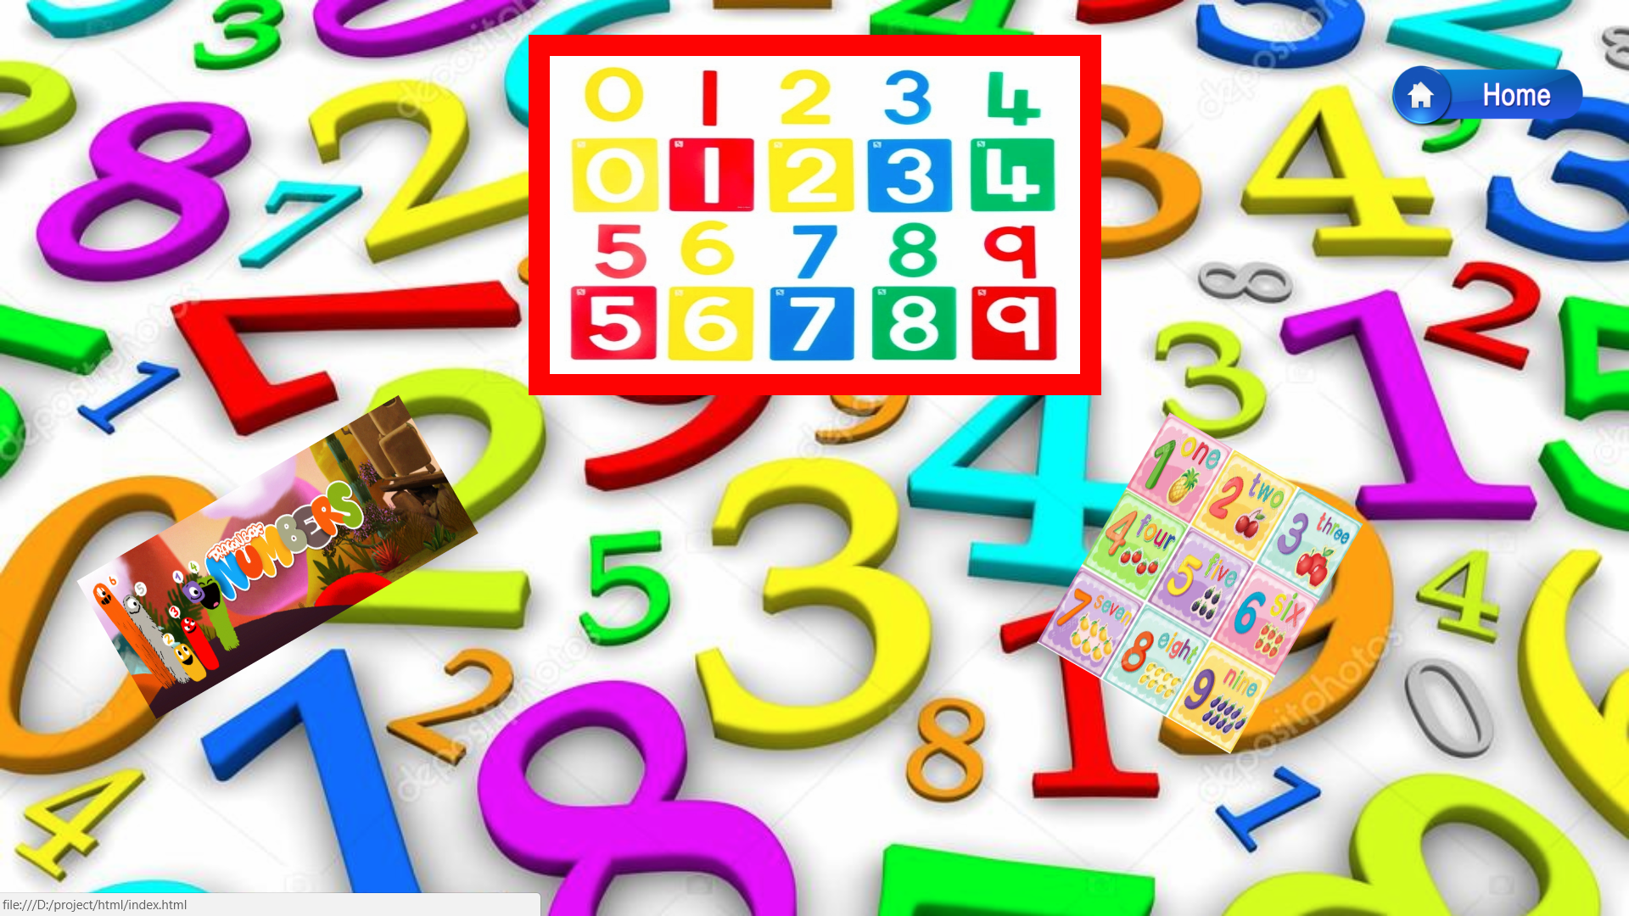
NUMBERS PAGE :
All the numbers are present in this page. Audio of the pronunciation of a particular number can be played by pointing and clicking the respective numbers.

Slide 11
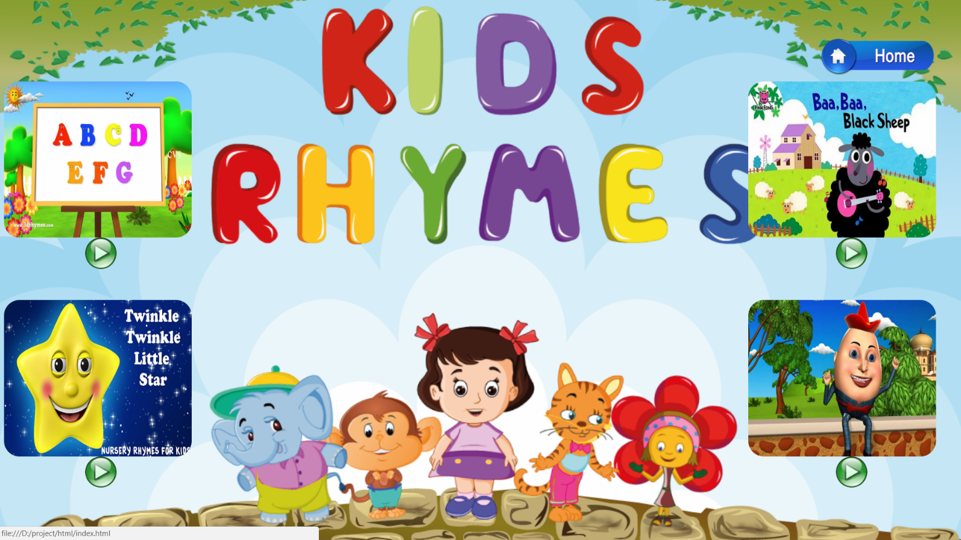
POETRY PAGE
Some of the common poetries are present in this page. Poetries can be played by pointing and clicking on the play button below the images of each poetry.

Slide 12
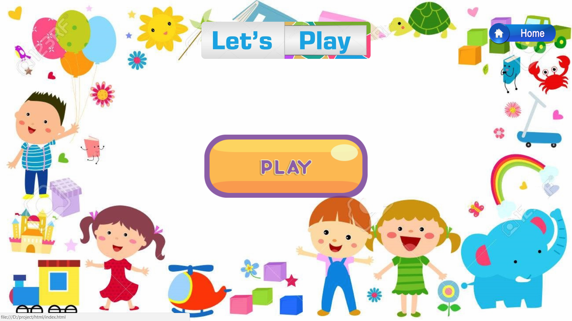
PLAY PAGE
On clicking the play button, number of games for kids like spot the difference, odd one out, etc. will appear in the page and can be selected by just clicking on that particular game.

Slide 13
CONCLUSION
Thus, this is the website which seek both to be educational as well as entertaining.
Children tends to explore such kind of websites where they can have fun and enjoyment.
In future, many other stuffs can be added like 3 or 4 letter words with proper pronunciations.
Animated videos can be added along with the poetries.
More games can also be added in this websites.

Slide 14
REFERENCES
https://www.stackoverflow.com
https://www.tutorialspoint.com
https://www.w3.org/TR/css3
https://www.w3.org/TR/html5
https://www.w3school.com

Slide 15
Thank you

